Slide 1
CONTENTS
Comparison of CC2-4 and CPCC2-4
Joint comparison of weights and BPC
CPCC rules

Slide 2
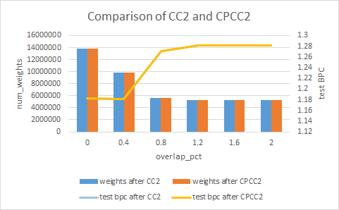

1. Comparison of CC2 and CPCC2

Slide 3
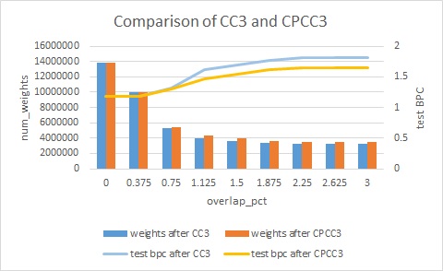
2. Comparison of CC3 and CPCC3

Slide 4
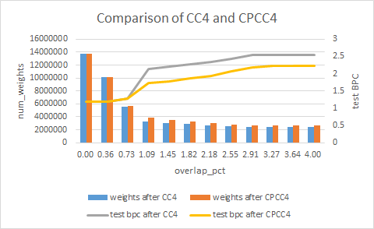
3. Comparison of CC4 and CPCC4

Slide 5
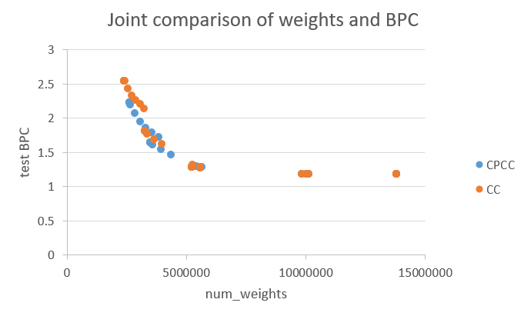
4. Joint comparison of weights and BPC

Slide 6
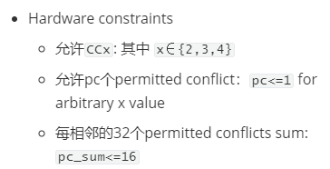
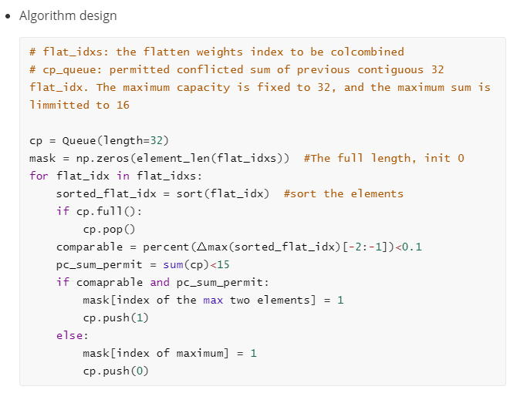
5. CPCC rules
Notes:
分块colcombine：
怎么去衡量block_size, max_path和overlap_pct的好坏？（根据）

